Slide 1
SIMS check up
Sprint 3
2022-10-07

Slide 2
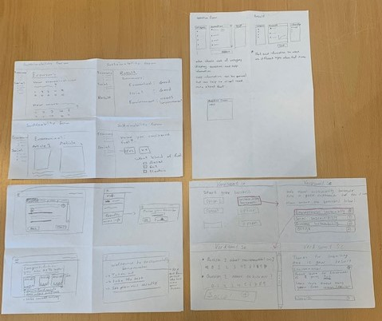
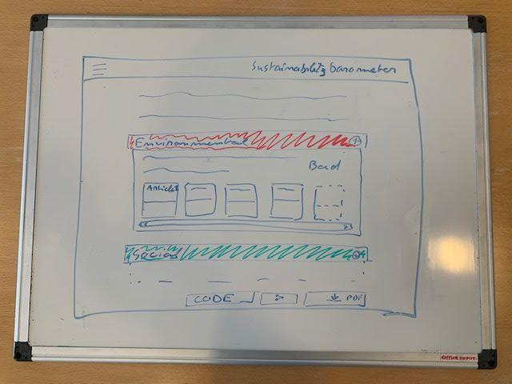
First mockups
Design studio exercise

Slide 3
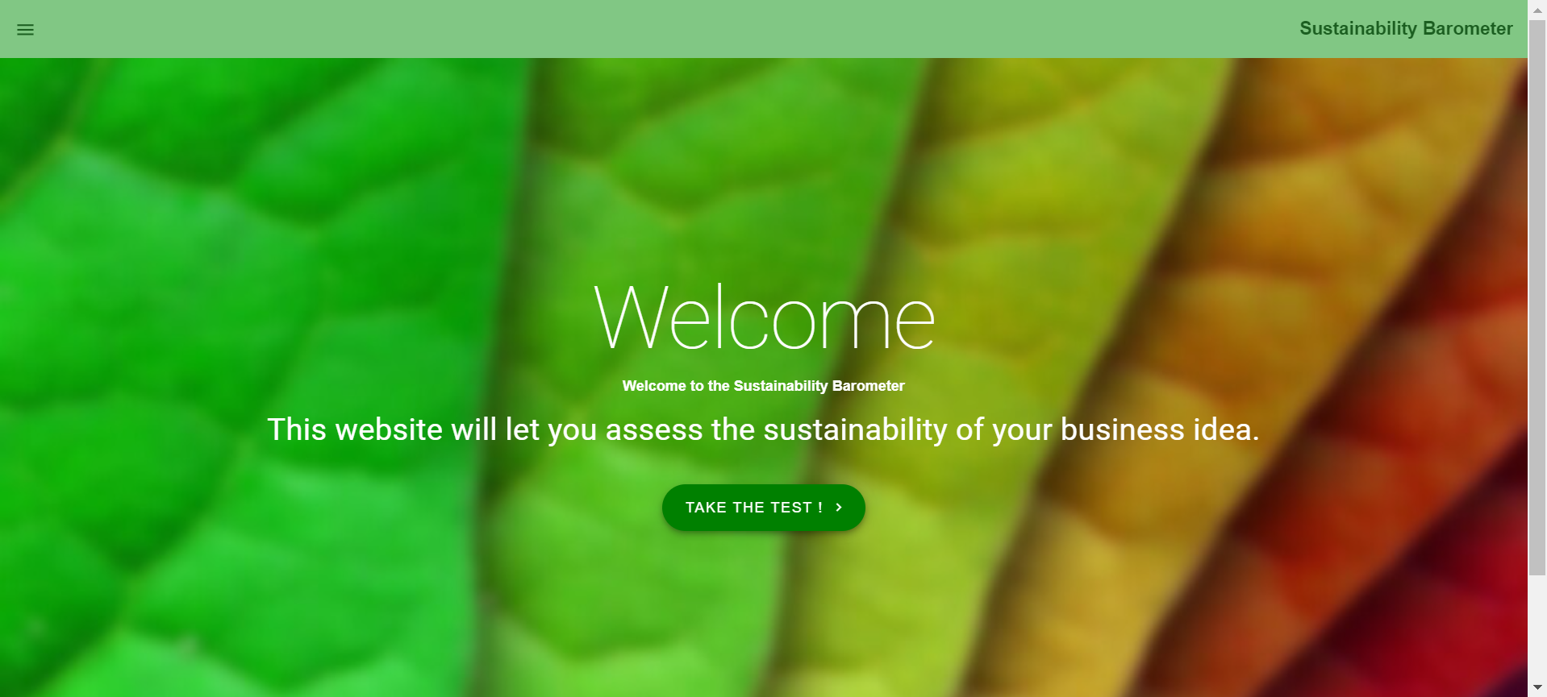
Landing page

Slide 4
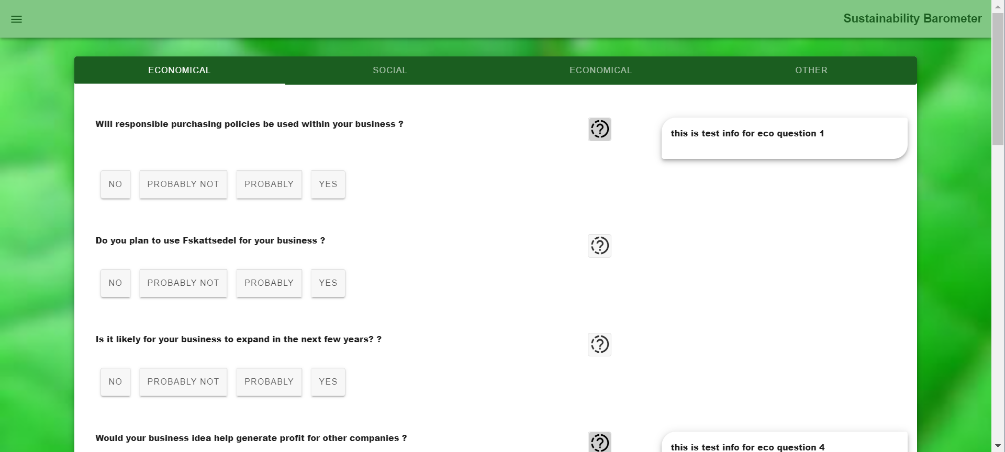
Form page

Slide 5
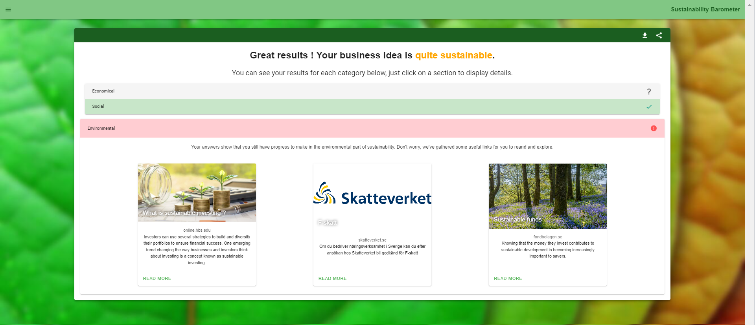
Result page

Slide 6
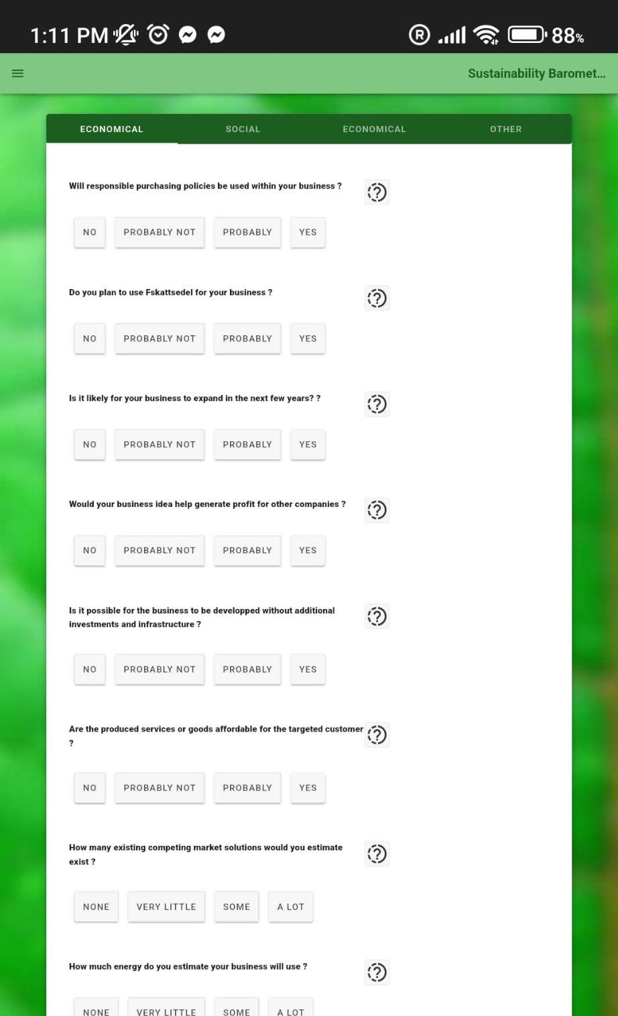
Mobile phone

Slide 7
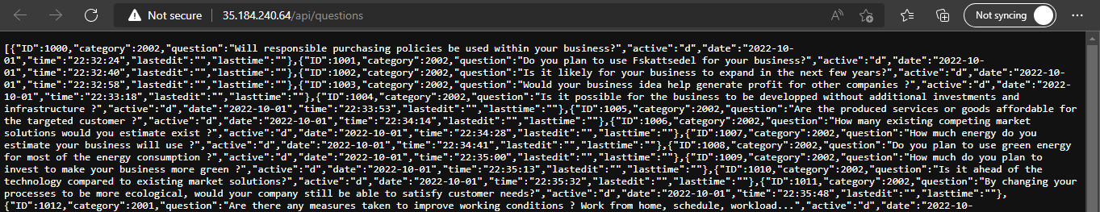
API

Slide 8
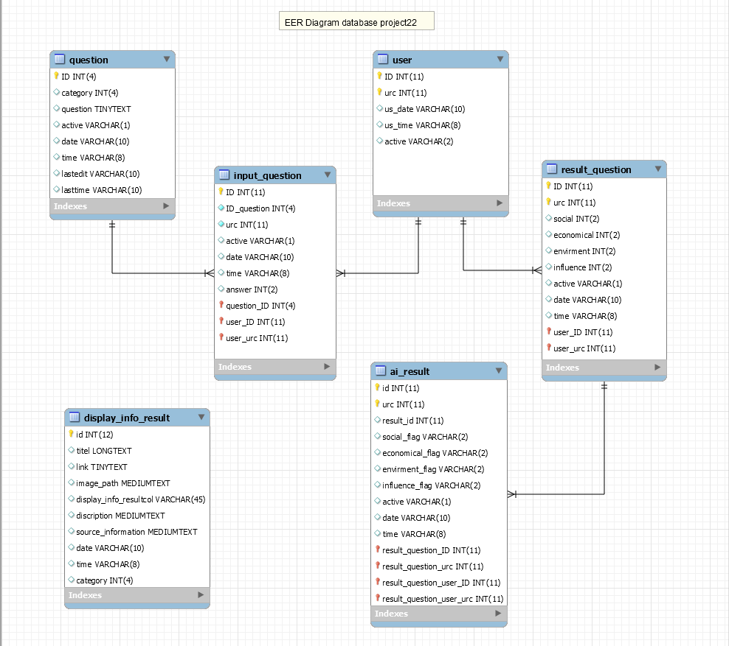
Database
Here is EER Diagram for project22 Database that show each table and how relative together.

Slide 9
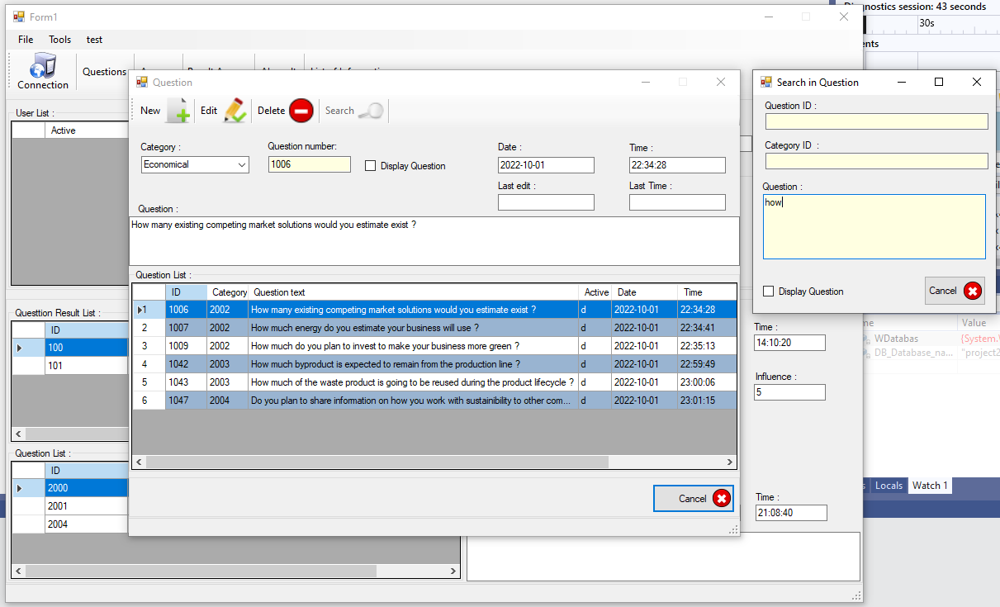
Backend Question part search

Slide 10
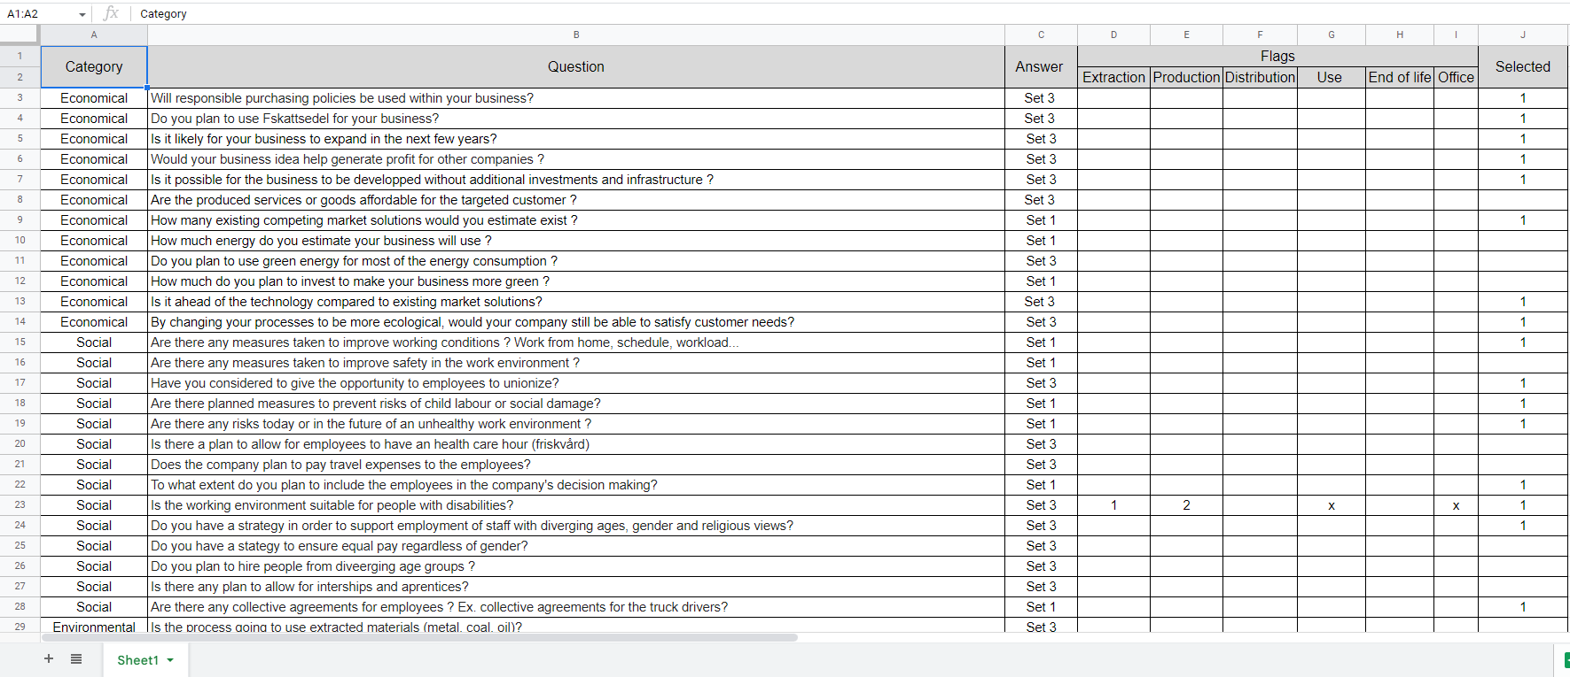
Questions for sustainability
Environmental
Social
Economic
Positive influence?

Slide 11
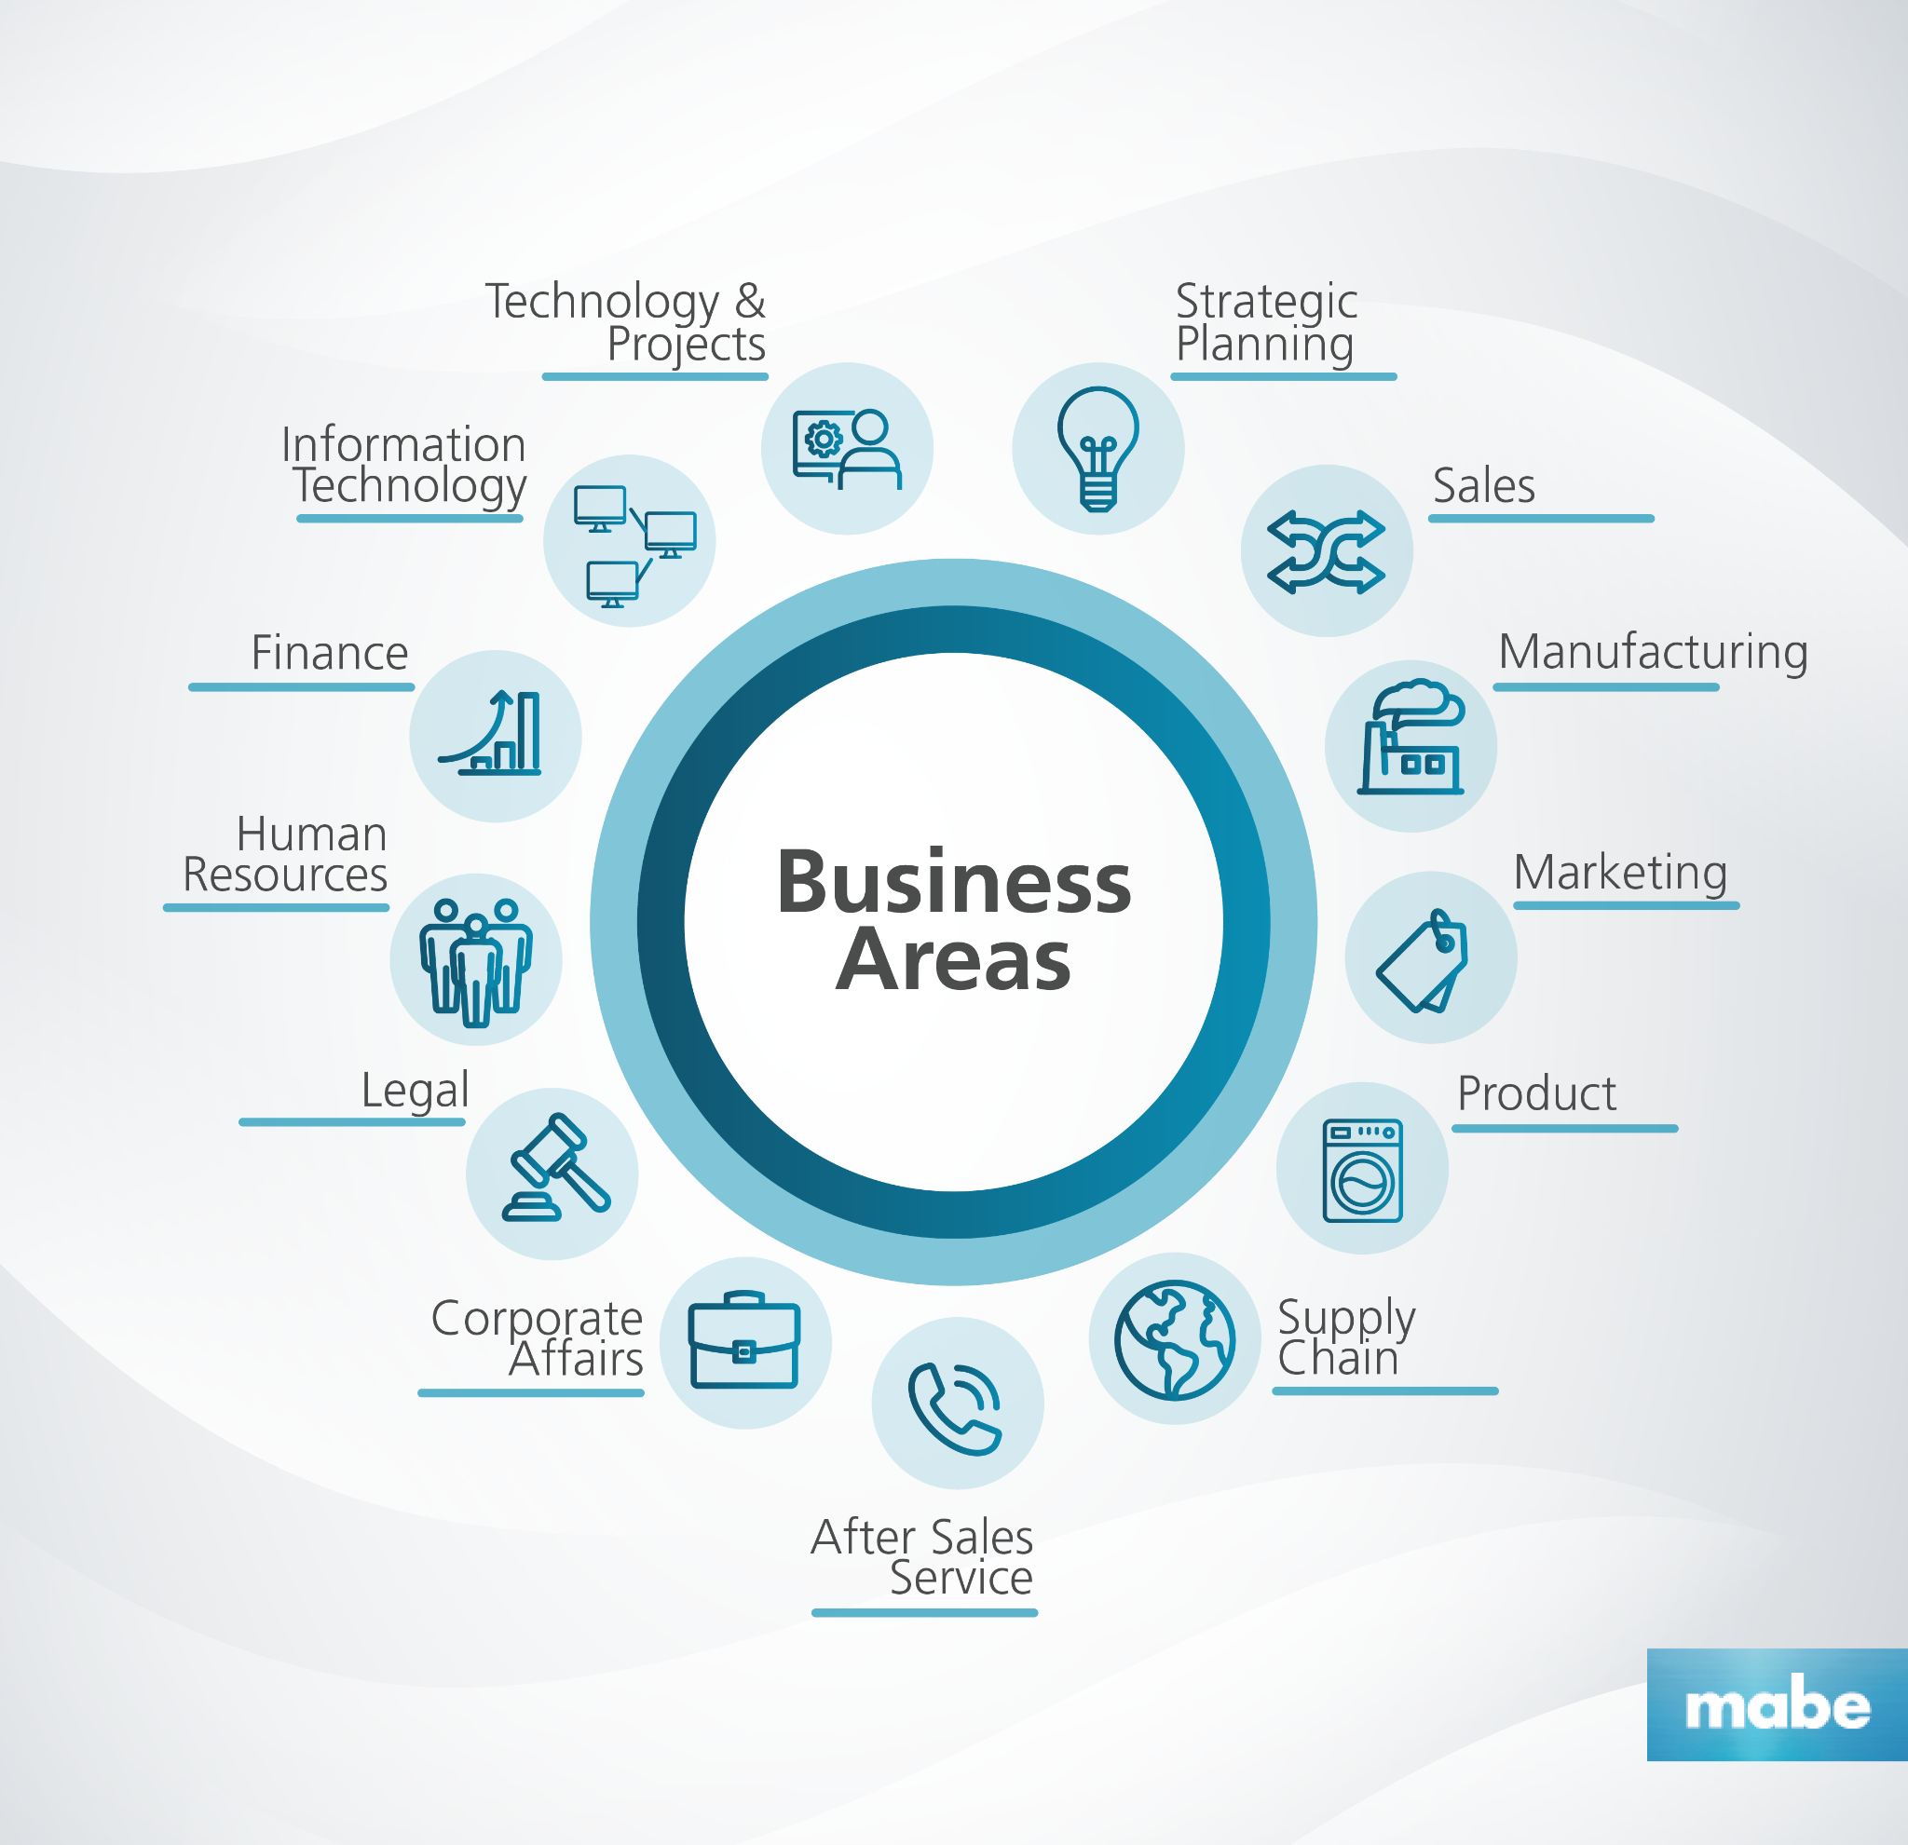
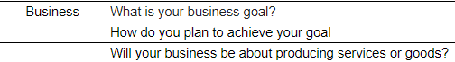
Weighting questions

Slide 12
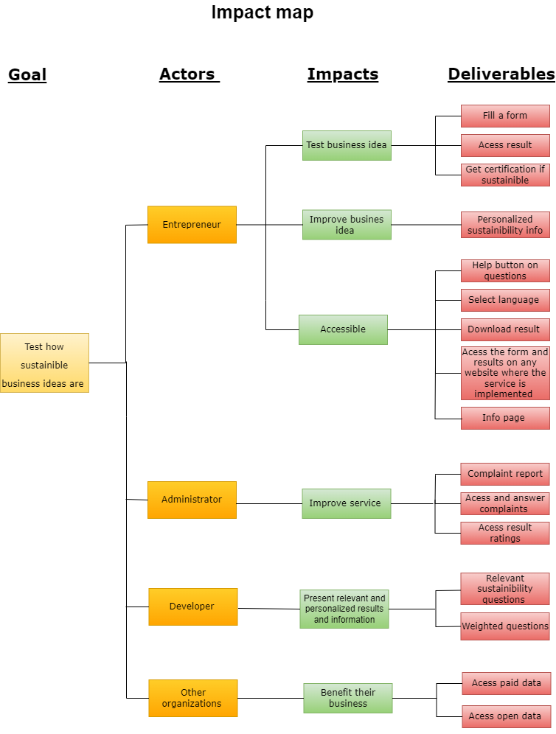
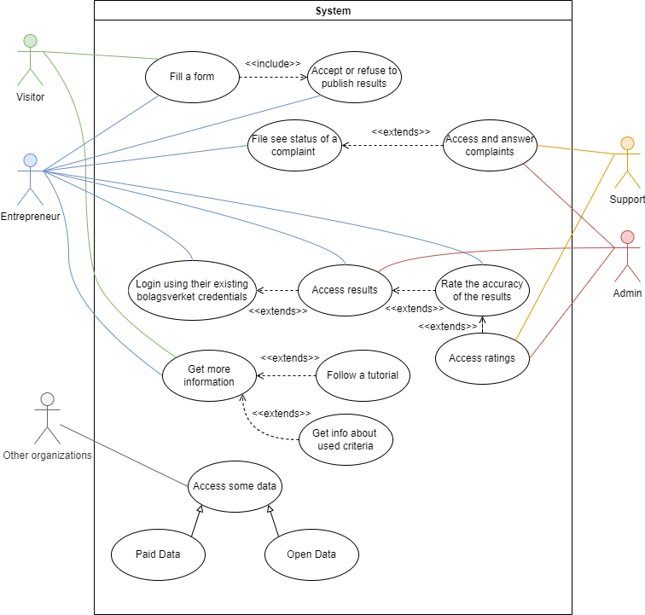
Requirement capturing
Use case diagram
Impact map
User stories
Kano model

Slide 13
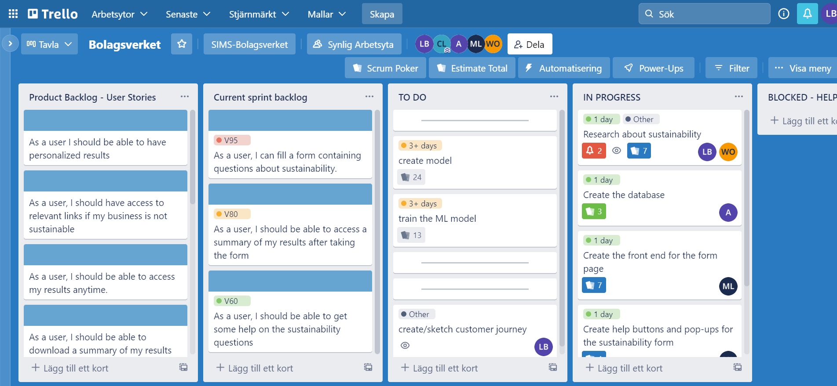
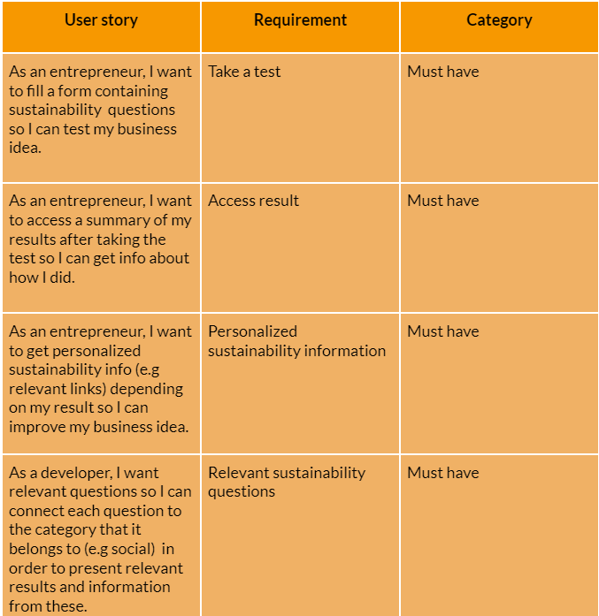
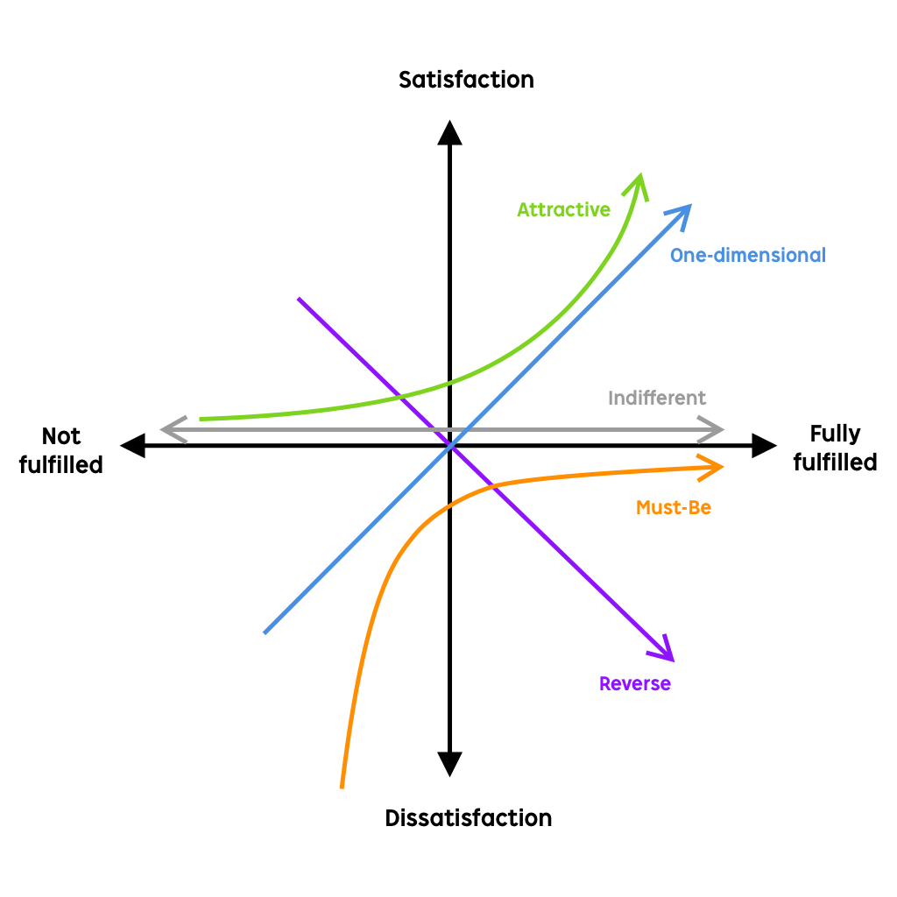
User stories in trello
Use case example :
Prioritized with Kano model

Slide 14
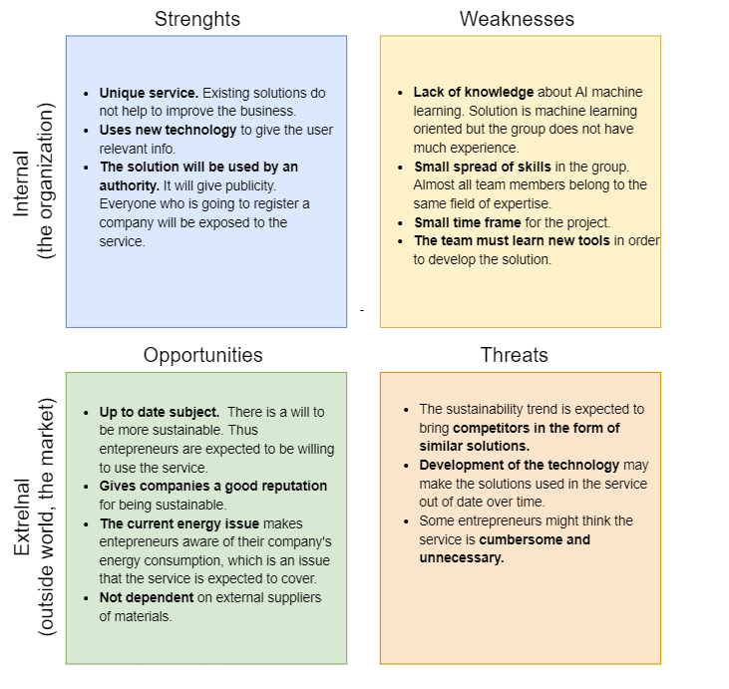
SWOT- analysis

Slide 15
What’s next?
Assign weights for questions
Connect back end to front end, API?
Continue to work on AI
Business plan

